Slide 1
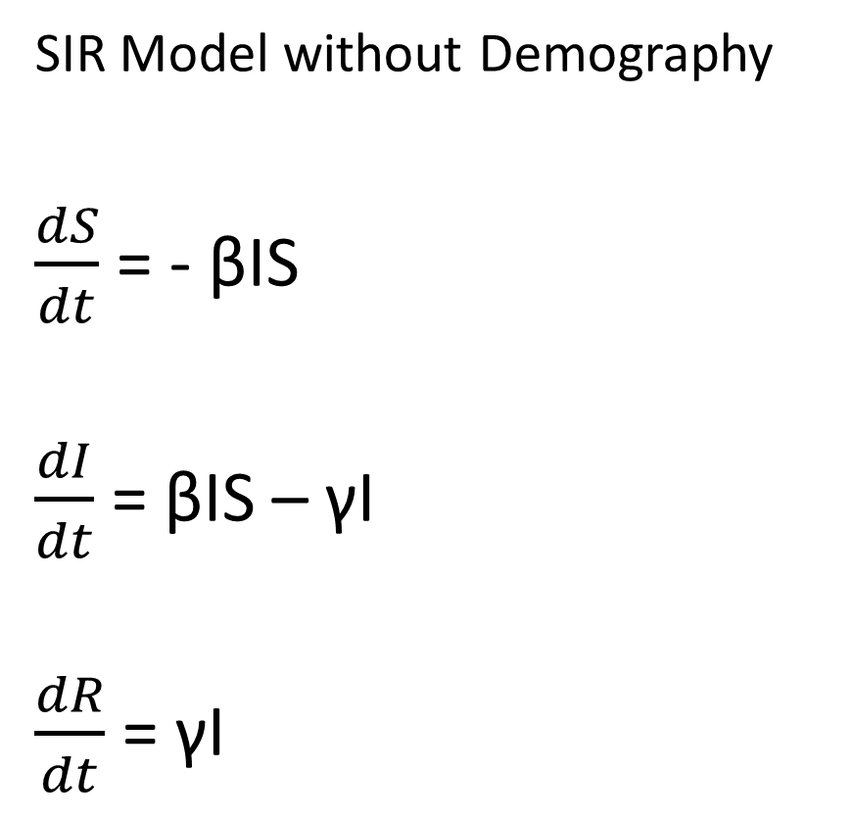
Incorporating Disease Dynamics…..
SIR Model without Demography
$\frac{dS}{dt}$ = - βIS
$\frac{dI}{dt}$ = βIS – γI
$\frac{dR}{dt}$ = γI
Closed population
Density dependent process
β transmission rate
γ recovery rate (1 / γ is the average infectious period)
R₀ (= β / γ)

Slide 2
Waterborne Disease
Giardiasis
Associated with poor sanitation and water quality (high prevalence reported from parts of Mexico)
In highly populated, urban areas where water sanitation is a problem, incidence can rise very quickly once a few people are infected
Notes:
Giardia lamblia protozoal parasite- potentially debilitating disease

Slide 3
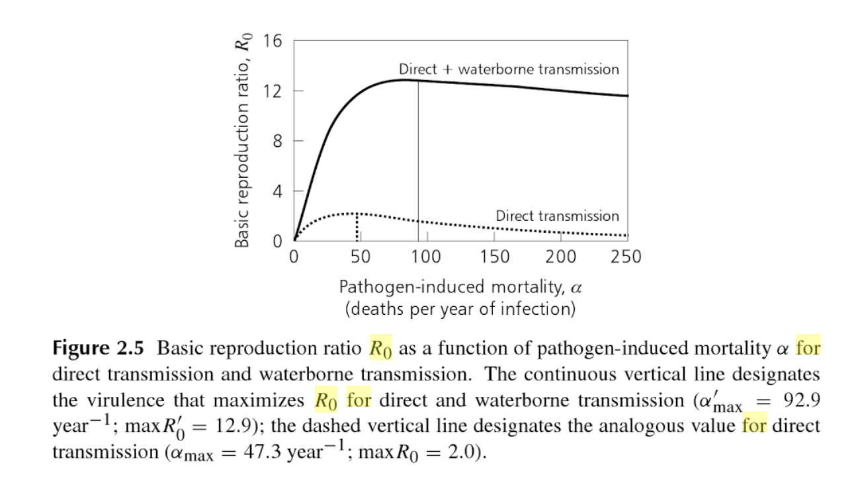


Slide 4

Simulating disease transmission….
To Hazard (patch process)
If flooding…
50% probability of disease outbreak
Transmission rate is scaled by the state of infrastructure in a patch
Spillover: Patches in a radius of 2 around the outbreak generate disease cases (up to 10% of total infections on the outbreak patch)
Notes:
(current age of infrastructure / threshold age of infrastructure)

Slide 5
Hypotheses….
Spatial pattern of disease incidence will reflect the state of sewage infrastructure
If disease outbreaks get more weightage in the Water Authority decision rubric, the overall age of sewage infrastructure will decrease over time
If disease outbreaks get more weightage in the Water Authority decision rubric, water scarcity issues will increase in frequency over time

